Slide 1
Spatial reprogramming
Jakob H. Schauser,
Biocomplexity, NBI,
TrusinaLab (and ITU)

Slide 2

How do physicist see the world?
All phenomena can be thought of as list of rules and corresponding boundary conditions:
differential equations
+ boundary conditions
=
Notes:
If we know how gravity pulls on a ball and where it started, we can calculate its trajectory.
Local rules lead to global emergent phenomena - but as we know from chaos theory, sometimes a system reacts unintuitively to change.

Slide 3
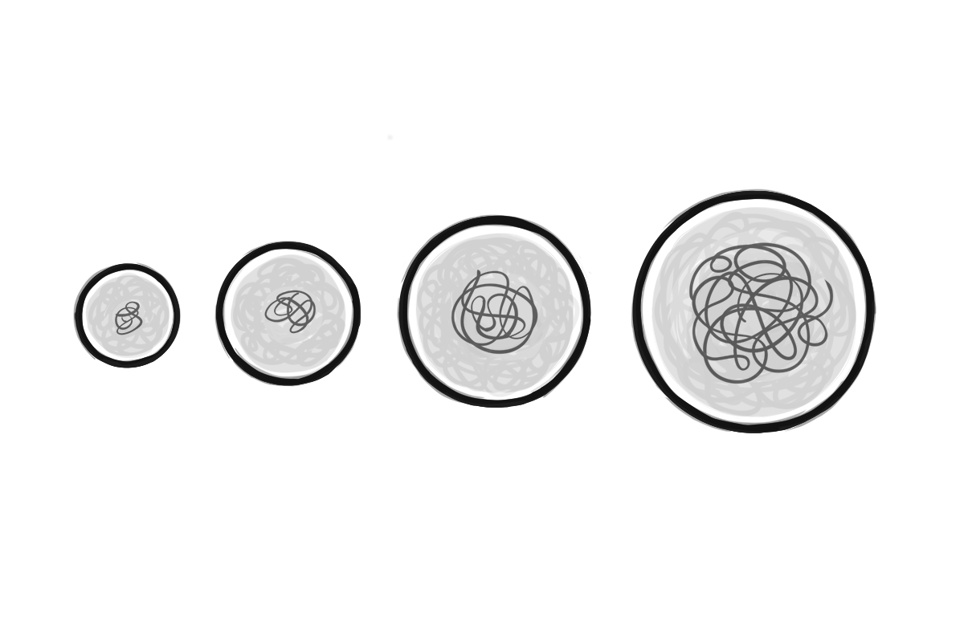
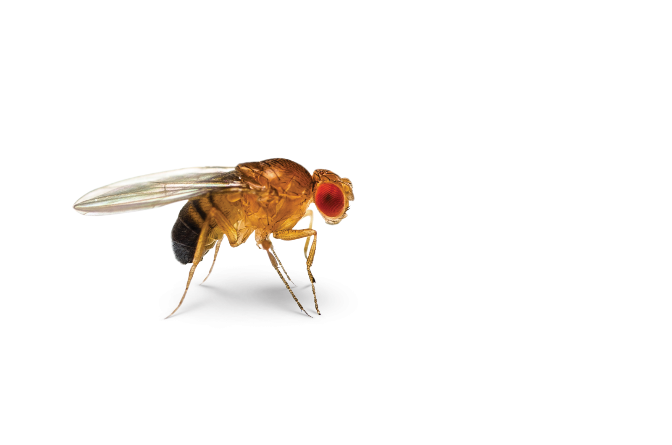
What will we be looking at?
Our work will be looking at the inherently interesting subject of morphogenesis, that is, the origin of physical shape. In nature, mind-bogglingly complex shapes, stem from relatively simple parts – no single cell knows the grand plan, but in collaboration, they can form almost anything.

Slide 4
What will we be looking at?
A lot of work has been put into understanding how different patterning organize morphogenesis. Small-scale symmetry breaks in (chemical nonequilibria) leads to large-scale, emergent structure. Some of this interaction is understood, but as everything happens through self-organization, tracing the path of information has been elusive.

Slide 5
What are our goals?
Our hypothesis
Growing organs
Inverse problem
Spatial (re)programming
Notes:
For scientists dreaming big, growing artificial organs as "replacement parts" will revolutionize the health-care industry. A reoccurring problem is that, without us truly understanding why, cells behave wildly different in-vitro (in a lab) compared to in-vivo (in the body). Their environment matter, but figuring out how these boundary conditions affect the cells (i.e. solving the inverse problem) is highly non-trivial.
Our hypothesis is, that if we understand the vocabulary of the individual cell (its rules) we can take that out of the equation, and change biological outcomes by smartly perturbing the initial conditions.
This is what we call spatial (re)programming.

Slide 6
What do we have?

Slide 7
Proof of concept: Drosophila Melongaster
Master Thesis

Slide 8
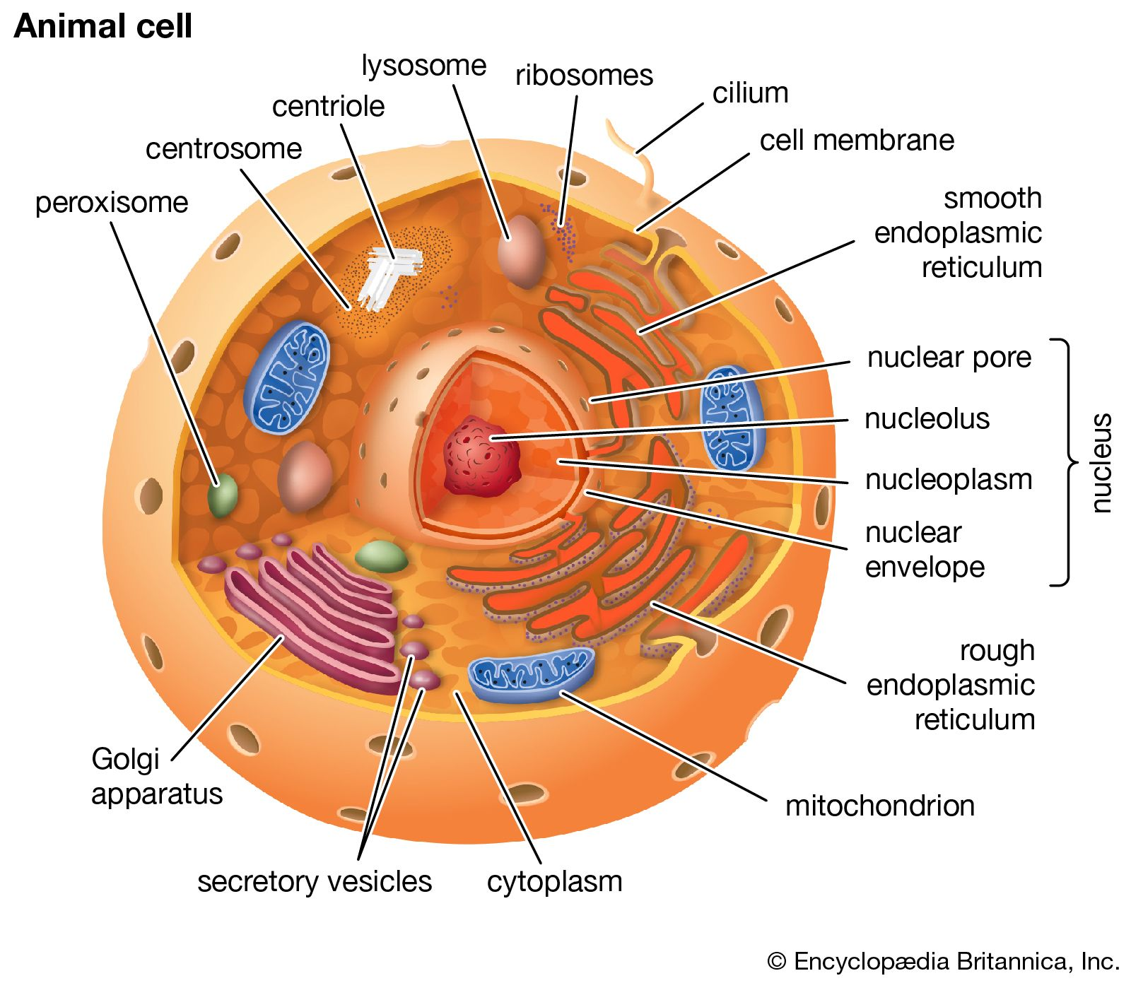
How do physicist see biology?
differential equations
+ boundary conditions
=
Notes:
If we know how gravity pulls on a ball and where it started, we can calculate its trajectory.
Local rules lead to global emergent phenomena - but as we know from chaos theory, sometimes a system reacts unintuitively to change.

Slide 9
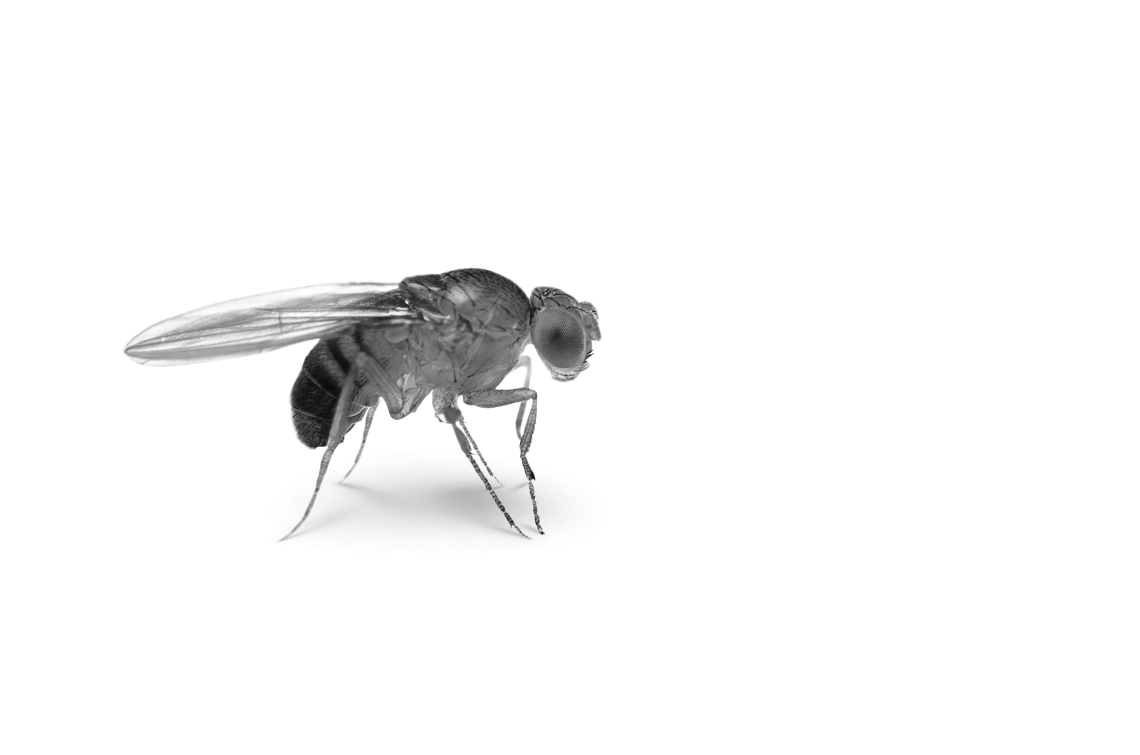
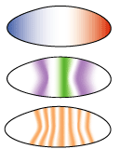
How do physicist see biology?
Not gonna go into the model :(
5000 cells, full embryo, never before successful
4-5 parameters, point-particles, no explicit timing
Full pipeline: From gene expression (data) to resulting shape
Notes:
If we know how gravity pulls on a ball and where it started, we can calculate its trajectory.
Local rules lead to global emergent phenomena - but as we know from chaos theory, sometimes a system reacts unintuitively to change.

Slide 10
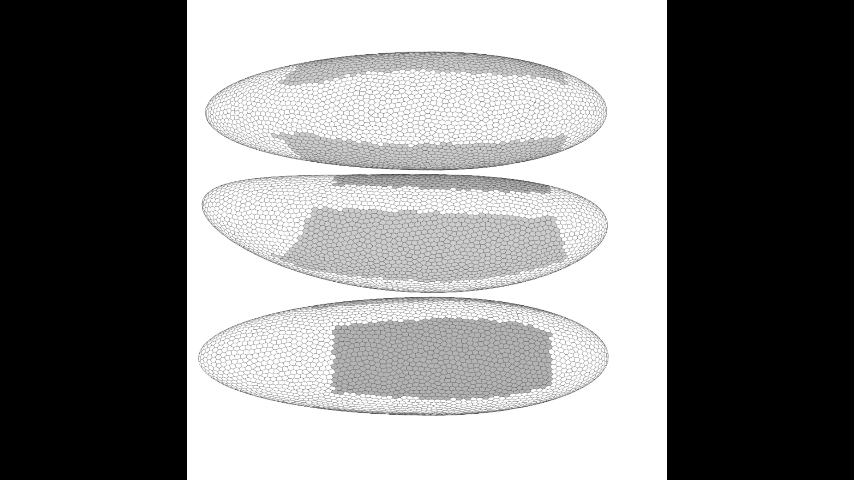
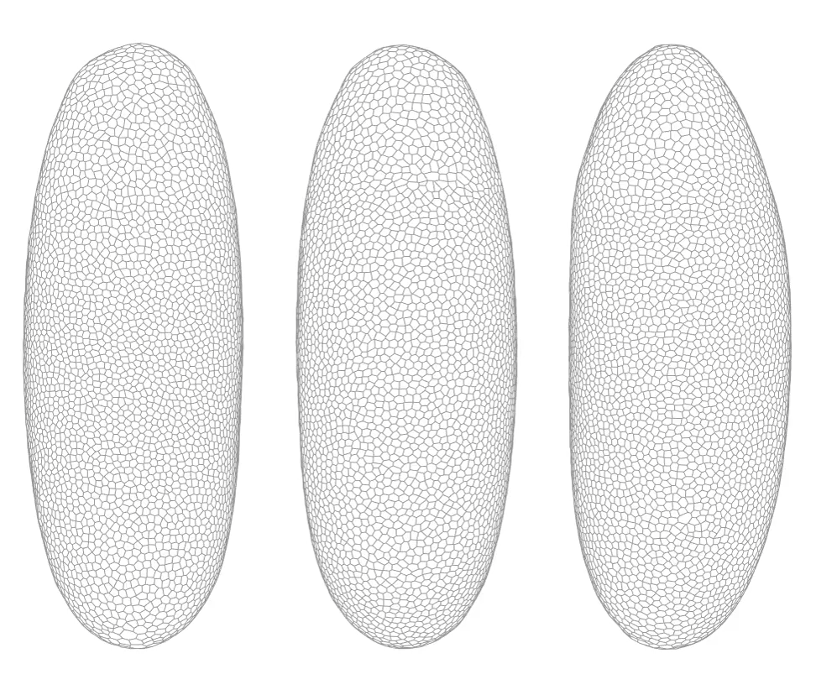
Data
Simulation

Slide 11
World first full-embryo simulation

Slide 12
What will we be doing now?
Experiments!
Neural Cellular Automata

Slide 13
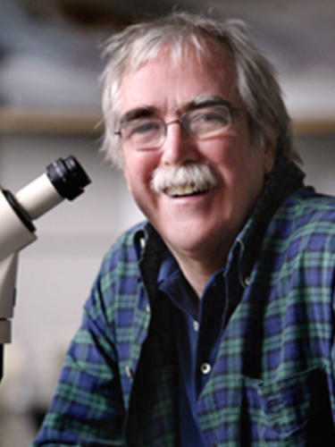
Experiments
We said “We can do science! We have predictions”
Biologists said “Put your (grant) money where your mouth is”

Slide 14
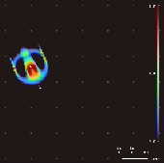
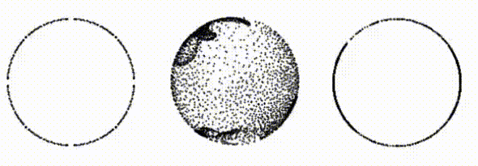
Neural Cellular Automata

Slide 15
Summary
Everything is just a list of rules and corresponding BC’s
Emulate/create biology
Understanding the rules allows us to perturb the BC’s
Spatial reprogramming!

Slide 16
Thank you for listening!
Always remember: You are spatial <3

